Slide 1

IMBD MOVIES
A DEEP DIVE ANALYSIS INTO PROFITABILITY
Analysis by Maria Zenchenko; Jun’23

Slide 2
Does a higher budget lead to higher rankings?
HYPOTHESIS TESTING
Higher budget
Higher rankings
Higher profit
Supposedly, higher investment means quality production which should lead to more popularity
We all often use IMBD/rotten tomatoes ranking to decide whether to watch a film or not; therefore higher rankings should lead to more viewings which in turn should lead to a film making more money, i.e. higher profitability
OBJECTIVE:
Provide movie producers and other industry professionals with insight into the movie financials based on past performance for future decision making
Notes:
.

Slide 3
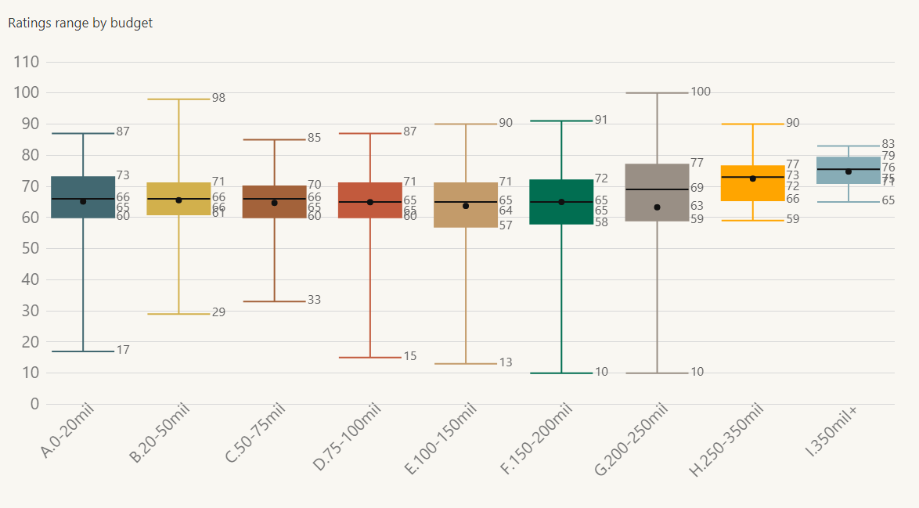
Does a higher budget lead to higher rankings?
Average score largely unaffected by the budget, slightly rising for spending above $250mil
Plenty of popular lower budget budget films and plenty of lower scoring higher budget ones.
ACTION: Other factors impact popularity and should be further investigated
CONCLUSION:
Budget doesn’t appear to be a predictable factor for ratings; therefore, don’t just pour money into an expensive production and expect success

Slide 4
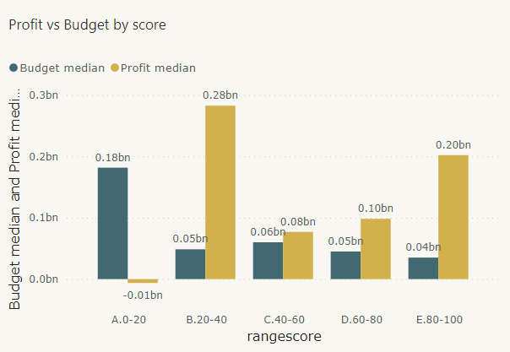
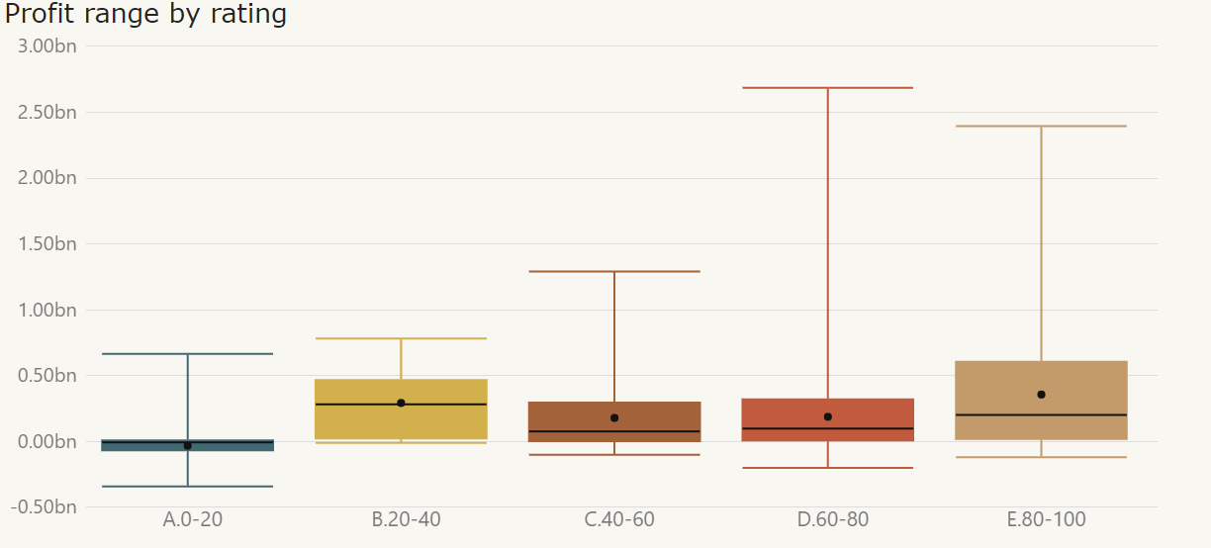
Are higher rated films more profitable?
WHILST median profit shows high profitability for lower ranking (20-40) films, there’s an obvious pattern of higher upscale of the profit as the ranking grows.
RECOMMENDATION:
invest in promising films with higher potential ranking
FINDINGS:
20-40 rating range was surprisingly profitable
80-100 rating range was the next most profitable category
Unsurprisingly, films with low ratings ( 0-20) made a loss in spite of a relatively high budget

Slide 5

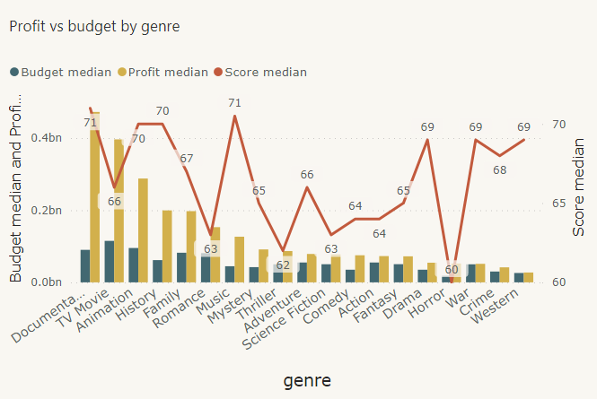


GENRES: Does popularity lead to profitability?
Romance and Horror genres had the lowest average scores
Animation, westerns and war films scored the highest
With only a slightly higher budget, TV movies and Documentaries appeared to be the most profitable, whilst not being the most popular

Slide 6
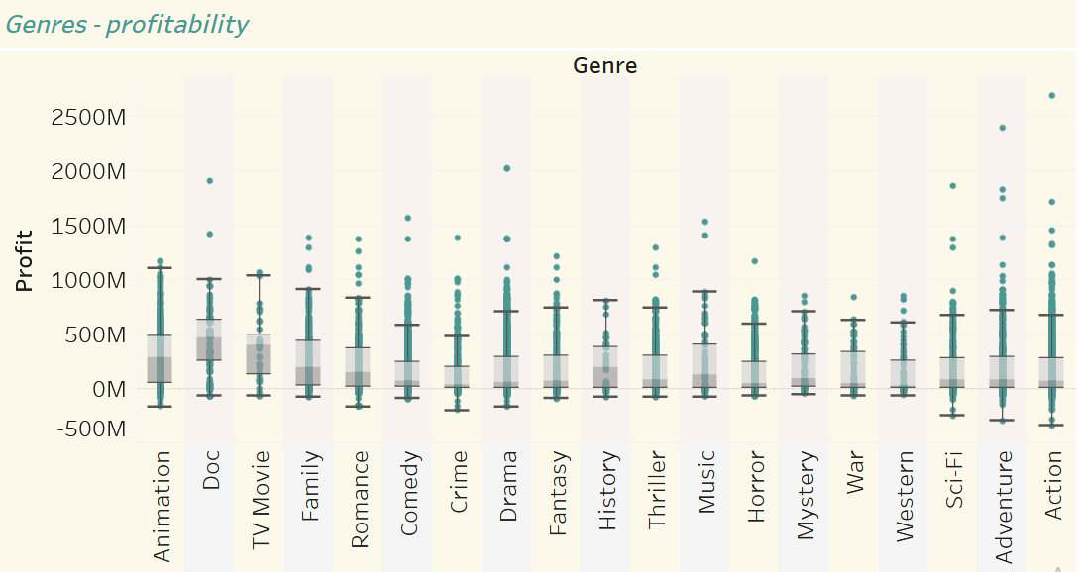
GENRES: profitability ranges
Action films seem to have the widest range
Animations appear to be the most potentially profitable on average
War, Western, Mystery and Horror genres have the smallest ranges making them less risky but also with lower max profits
Link to Tableau
CONCLUSION:
Consider your risk appetite and whether you can afford to potentially make a loss for a potentially higher gain when selecting which genres to invest in

Slide 7
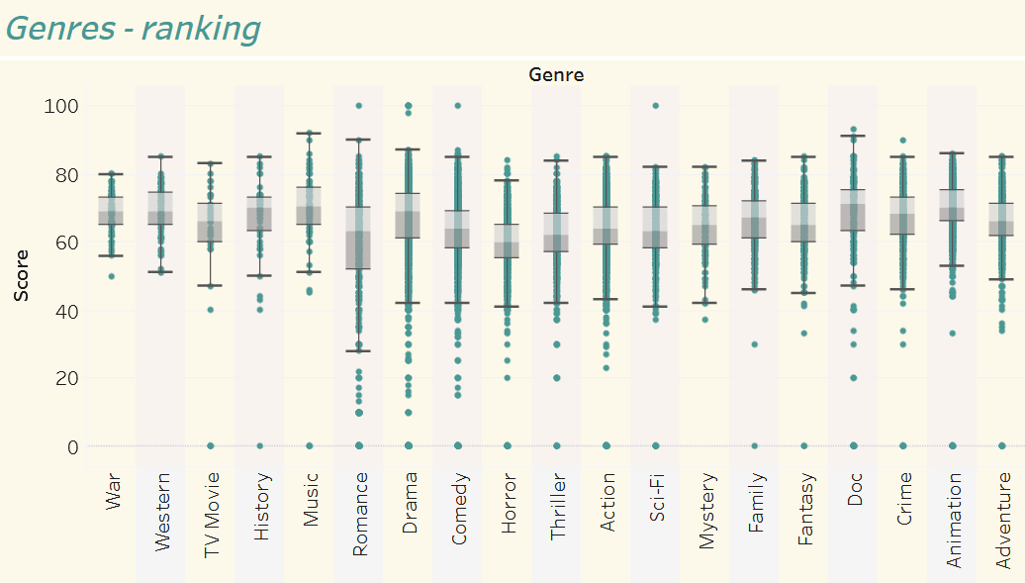
GENRES: popularity ranges
Link to Tableau
War and western genres appear to be the safest bet – a lower range of scores
Dramas, comedies and romance genres are the riskiest with a very high range of scores
CONCLUSION:
If popularity/ score is the endgame, war films and westerns are the go-to genres which are almost guaranteed to be successful

Slide 8
Key insights
Budget isn’t a predictable factor for popularity
More popular films are more likely to be more profitable, HOWEVER
less popular films can also be surprisingly profitable
Some genres are safer than others, popularity and profitability wise
Recommended actions
Investigate further which factors lead to popularity
Invest in films which possess those factors
Use genre analysis to choose most suitable risk vs payoff scenario

Slide 9
METHODOLOGY
Data cleansing performed:
Genres simplified from including several to the first one on the list –assumed primary
0 rankings removed = assumption every film would get >0
Blank genres removed
Microsoft Excel ( pivots and charts), Power BI and Tableau Public used to produce the charts and graphs
Data source: https://www.kaggle.com/datasets/ashpalsingh1525/imdb-movies-dataset

Slide 10
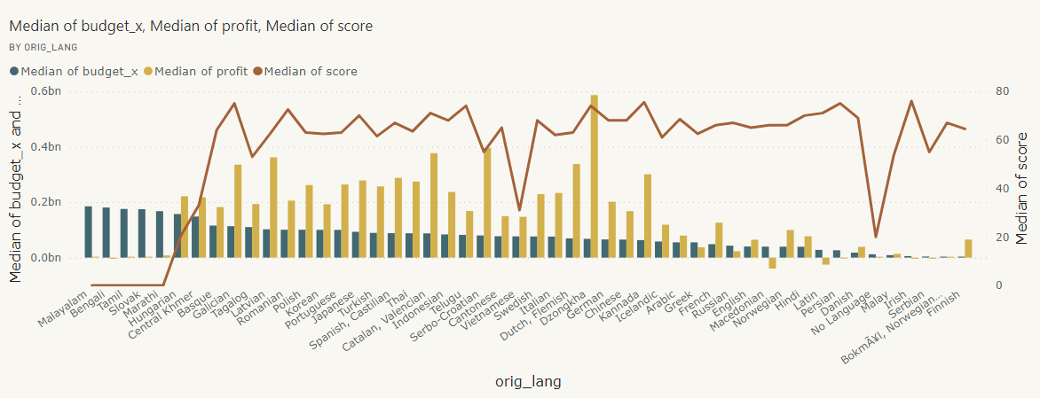
APPENDIXES
Languages – budget profitability and ranking

Slide 11
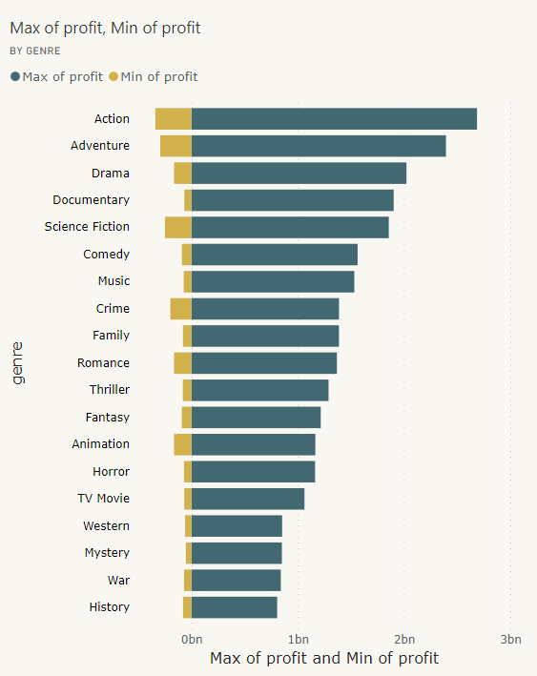
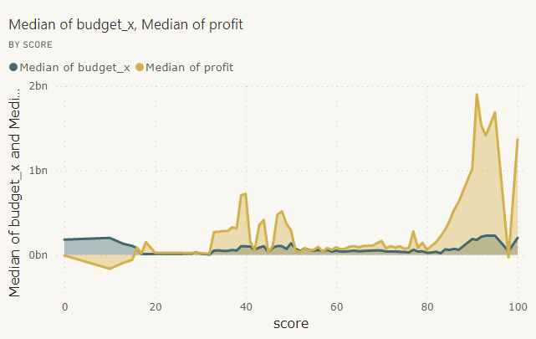
APPENDIXES
Open in Power BI
Profitability – by ranking
Profitability – by genre

Slide 12
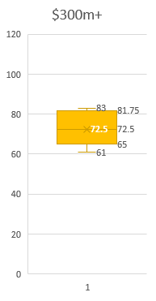
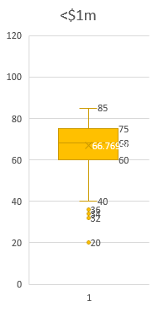
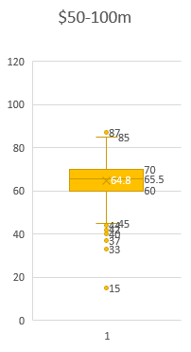
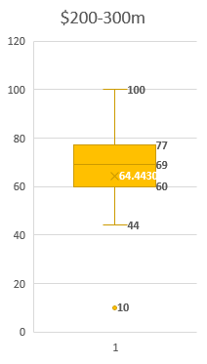
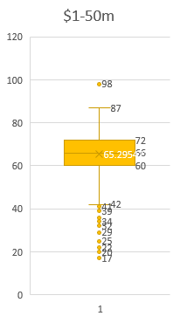
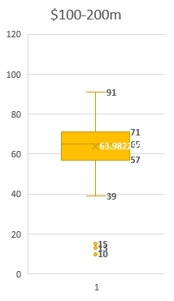
Ranking distribution by budget
There appears to be a more concentrated distribution with a far higher average (72.5) for $300m+ budget
There are more lower scoring outliers with the budget range $1-50m
The distribution range is lower for $200mil+ budget, indicating some correlation

